Slide 1
Poly Q project: are glutamate rich protein regions enriched in synaptic proteins, and if so, do they have a biological role at synapses?

Slide 2
Chemical Synaptic Transmission
ACTION POTENTIAL
PRESYNAPTIC CALCIUM INFLUX
SYNAPTIC VESICLE FUSION
Ca²⁺
Ca²⁺
NEUROTRANSMITTER
NEUROTRANSMITTERS ACTIVATE RECEPTORS
IONS
Notes:
Brief overview of synaptic transmission

Slide 3
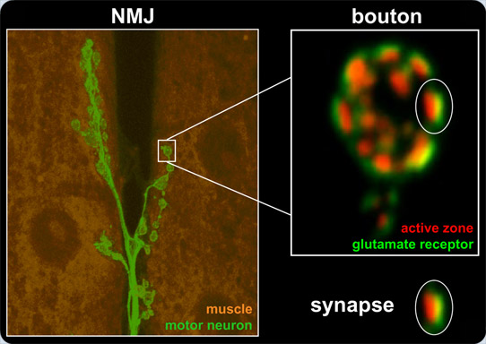
Fly Neuromuscular Junction
Sigrist

Slide 4
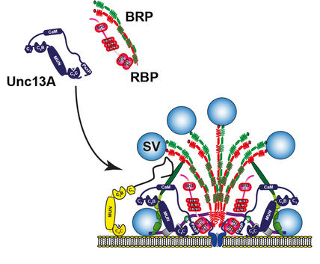
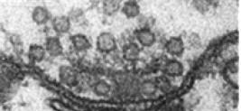
Active Zone

Slide 5
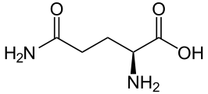
Glutamine at the Active Zone

Slide 6
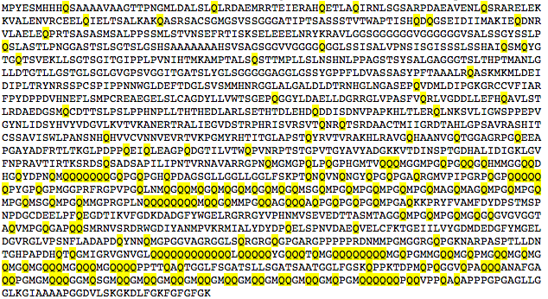
Rim Binding Protein has a lot of glutamines…

Slide 7
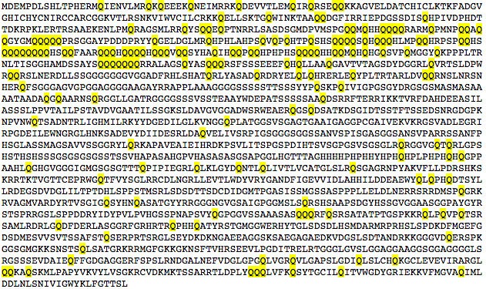
RIM

Slide 8
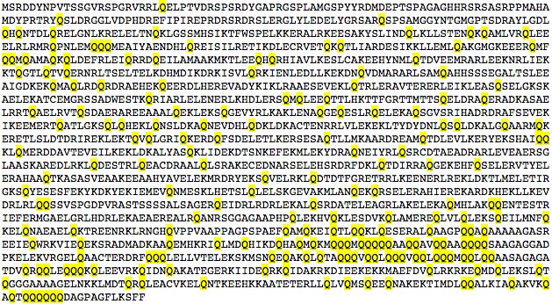
BRP

Slide 9
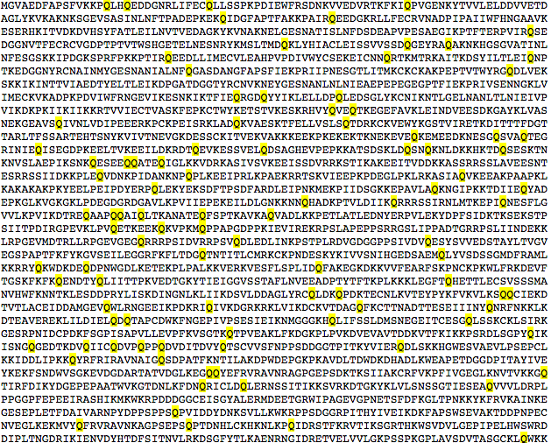
Normally proteins look more like this (titin)

Slide 10

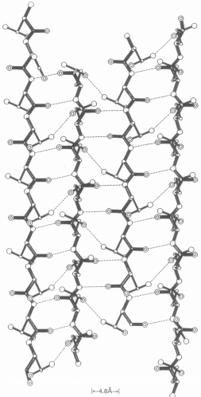
Often unstructured
Interact with each other (H-bonds)
protein protein interactions
Large insoluble aggregates (Inclusion bodies) → disease
Longer polyQ tracts → increase transactivation potential (DNA-binding
Polar zippers

Slide 11
Preliminary Analysis of Q-Rich Regions
Randomly Choose 1000 Drosophila Proteins
Annotate Sequences Using Hidden Markov Model
Filter Out Nuclear Proteins
See if “Hits” are Synaptic

Slide 12
Hidden Markov Model
Sequence Annotation

Slide 13
Given an amino acid sequence, how do we annotate Q-stretches?
QMSGQMPGQMMGPRGPLNQQQQQQQQMQQGQMMPGQQAGQQQAQPGQPGQPGQMPGA
QMSGQMPGQMMGPRGPLNQQQQQQQQMQQGQMMPGQQAGQQQAQPGQPGQPGQMPGA
Probability of leaving a Q-tract
STATES:
HIDDEN
STATE #1:
Q-Rich
STATE #2:
Normal
Probability of staying in a
Q-tract
Probability of staying in normal sequence
Probability of entering a Q-tract
P(Q)
P(Q)

Slide 14
HMM for PolyQ with Informally Estimated Parameters
P(transition) = 0.13
STATE #1:
Q-tract
STATE #2:
Normal
P(stay) = 0.87
P(stay) = 0.95
P(transition) = 0.05
P(Q) 0.26
P(Q) = 0.05

Slide 15
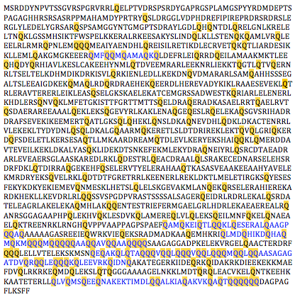
HMM Annotates proteins (BRP)
Blue: HMM detected Q-tract
Questionable regions: I current HMM parameters have a tendency towards false positives

Slide 16
1000 random proteins: grey = nuclear, mitochondrial, not neuronally expressed, or CG
Bruno
Little imaginal discs
Gawky
Absent, small, or homeotic discs 1
Rhinoceros
Lilliputian
Timeless
Hormone receptor 3
Pre-mod(mdg4)-V
Rab3 GDP-GTP exchange factor
Bazooka
Shaker isoform T
Tiny tim 50
Tau
Rim binding protein
Octopamine beta2 receptor
Molecule interacting with CasL
Canoe
Piezo-like, partial
Myosin 81F
Abdominal B
Fork head, isoform E
NK7.1 isoform D
FMR1, isoforms K,J
Phosphopantothenoylcysteine synthetase
Octopamine receptor in mushroom bodies
Melanization protease 1
Glutamate receptor 1B
Down syndrome cell adhesion molecule 2
Capricious, E
Ventral veins lacking
Ecdysone-induced protein 75B
Mushroom-body expressed
Knirps-like
Ftz TF
Wnk kinase
Transmembrane channel-like
Multiple C2 domain and transmembrane region protein
Combgap
Sin3A
Pipsqueak
Pre-lola-G
Ran-binding protein M
Protein kinase N
Lingerer
DAG kinase
Bicoid-interacting protein 3
Nipped-A
Myosin heavy chain
Yuri gagarin
Kekkon-1
Embargoed
Piezo
Smt3
Turtle
Earmuff
Rab26
Knirps
Kugelei
Su(Tpl)
Caprin
Mediator complex subunit 19
Chromator
CREB-regulated T-coact
Bloated tubules
Abl tyrosine kinase
Short spindle 2
Spt20
Eyegone
IRSp53
Klumpfuss
Metal response element-binding TF
Nervous wreck
Tequila
Upstream of N-ras
Ankyrin 2
Claspin
Blimp-1
Veloren
Still life
Spinophilin
Myocardin-related TF
Mediator complex subunit 14
Klarsicht
No long nerve cord
No mechanoreceptor potential B

Slide 17
Orange: Annotated Q-tracts are weak by eye (blinded)
Rab3 GEF (some isoforms)
Bazooka (all)
Shaker (some isoforms)
Tau (some isoforms)
Rim binding protein (all)
Octopamine beta2 receptor
Molecule interacting with CasL (all)
Canoe (some isoforms)
Piezo-like, partial
Myosin 81F
FMR1, isoforms K,J (some isoforms)
Phosphopantothenoylcysteine synthetase
Octopamine receptor in mushroom bodies
Melanization protease 1
Dscam 2 (some isoforms)
Capricious (some isoforms)
Wnk kinase (all)
Transmembrane channel-like
Multiple C2 domain and transmembrane region protein
Ran-binding protein M (all)
Protein kinase N (all)
DAG kinase (all)
Myosin heavy chain
Kekkon-1
Piezo
Turtle
Rab26
Kugelei
Bloated tubules
Abl tyrosine kinase (some isoforms)
IRSp53 (some isoforms)
Nervous wreck
Tequila
Ankyrin 2
Veloren (some isoforms)
Still life (all)
Spinophilin (all)
No long nerve cord
No mechanoreceptor potential B

Slide 18
Final set: 22 “Hits” out of 1000 random Drosophila proteins
Rab3 GEF (some isoforms): AT THE ACTIVE ZONE ***
Bazooka (all): SYNAPSE ASSEMBLY ***
Shaker (some isoforms): REGULATION OF SYNAPTIC ACTIVITY ***
Tau (some isoforms): MICROTUBULE-ASSOCIATED
Rim binding protein (all): AT THE ACTIVE ZONE ***
Molecule interacting with CasL (all): SYNAPSE ASSEMBLY ***
Canoe (some isoforms): SCAFFOLD PROTEIN
FMR1, isoforms K,J (some isoforms): SYNAPTIC RNA LOCALIZATION ***
Dscam 2 (some isoforms): TRANSMEMBRANE, SYNAPSE FORMATION ***
Capricious (some isoforms): SYNAPSE ASSEMBLY, AXON GUIDANCE ***
Wnk kinase (all): AXON GUIDANCE
Multiple C2 domain and transmembrane region: DENDRITE MORPHOGENESIS ***
Ran-binding protein M (all): CELL ADHESION, CYTOSKELETON
Protein kinase N (all): ACTIN, MORPHOGENESIS
DAG kinase (all): PHOTOTRANSDUCTION ***
Turtle: SYNAPTIC TARGET RECOGNITION ***
Bloated tubules: NEUROTRANSMITTER/SODIUM SYMPORTER ***
Abl tyrosine kinase (some isoforms): AXON GUIDANCE, DENDRITE MORPHOGENESIS ***
IRSp53 (some isoforms): FILOPODIUM ASSEMBLY, MEMBRANE ORGANIZATION
Veloren (some isoforms): AXON GUIDANCE, DENDRITE MORPHOGENESIS ***
Still life (all): LOCALIZED TO PRESYNAPTIC TERMINALS ***
Spinophilin (all): ACTIVE ZONE ASSEMBLY ***

Slide 19
Models for what Q-tracts could be doing
Protein-protein interactions between AZ proteins → help AZ proteins cluster?
Bind to lipids?
Part of a known protein domain?

Slide 20
Future directions – computational
Train HMM with Baum-Welch
Automate nuclear filtering step
Entire neuronal transcriptome
Entire human genome
Do we pull out more synaptic proteins with PolyQ than without?
Look at CG proteins
Look at isoform expression data

Slide 21
Future directions - experimental
GFP-PolyQ-NES
Cpx-PolyQ
G → D mutations (and/or truncations) in AZ proteins with good antibodies
Tagged Q-specific isoforms
RNA isolation / qPCR → isoform information

Slide 22
END

